Slide 1

Predicting Movie Investment Risk
Data Science Capstone Project August 2025
By Jeremy Jex

Slide 2
The Problem
When investing in a movie, how do you know if it will be successful or a flop?
Notes:
The Problem
When investing in a movie, how do you know if it will be successful or a flop?

Slide 3
Who Might Care
Movie Production companies
Actors
Theaters
Notes:
Stake holders
Production companies
Actors
Theaters
Ect.

Slide 4
Features that can Affect Movies
Movie creators want to profit off their movies and many factors influence that
This data set includes
Title
Release dates
Budget
Gross
Genre
Runtime
MPAA rating
Review ratings
Number of Reviews
Notes:
Features of this data set include:
Title
Release dates
Budget
Gross
Genre
Runtime
MPAA rating
Review ratings
Number of Reviews

Slide 5
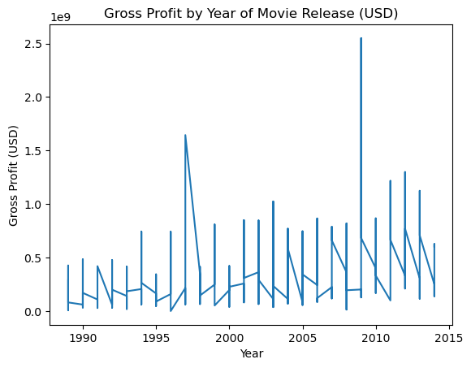
The Data Set
Billion
Billion
Kaggle Movie data set
500 Blockbuster Movies
1988 to 2014
Notes:
The graph shows Gross profit of movies by year. Each year spans the minimum and maximum gross profit. You can see the fist spike is Titanic which is above 1.5 billion. Avatar is the second spike at over 2.5 billion.

Slide 6

Data exploration

Slide 7
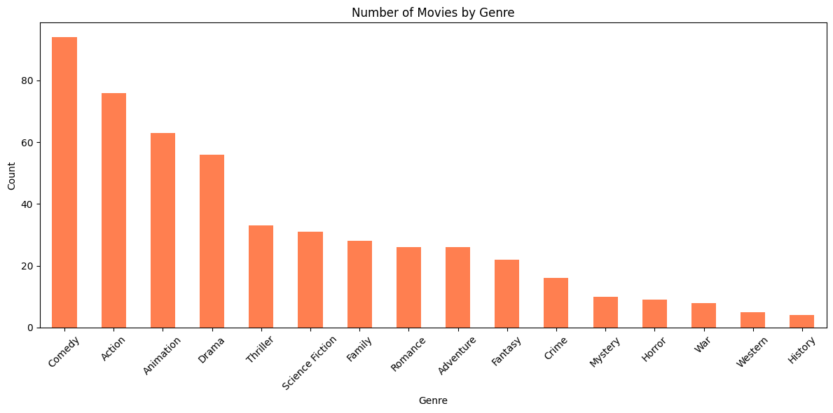
Movies by Genre
Notes:
The Genre distribution of this data set does not sample equally from all genres, this can cause bias towards the respective genres affected. Comedy, action, animation and drama are over represented when compared to the other genres.

Slide 8
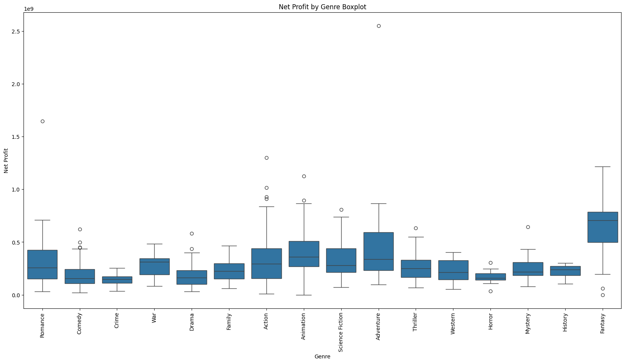
Net Profit Grouped by Genre
Avatar and Titanic were removed
Notes:
This boxplot shows movies’ net profit (USD in Billions) groped by genre. Avatar and the Titanic were removed from the data set due to being outliers. You can see Avatar as an outlier in the adventure genre and Titanic as a n outlier in the romance genre. The Net Profit of the genres are relatively similar.

Slide 9
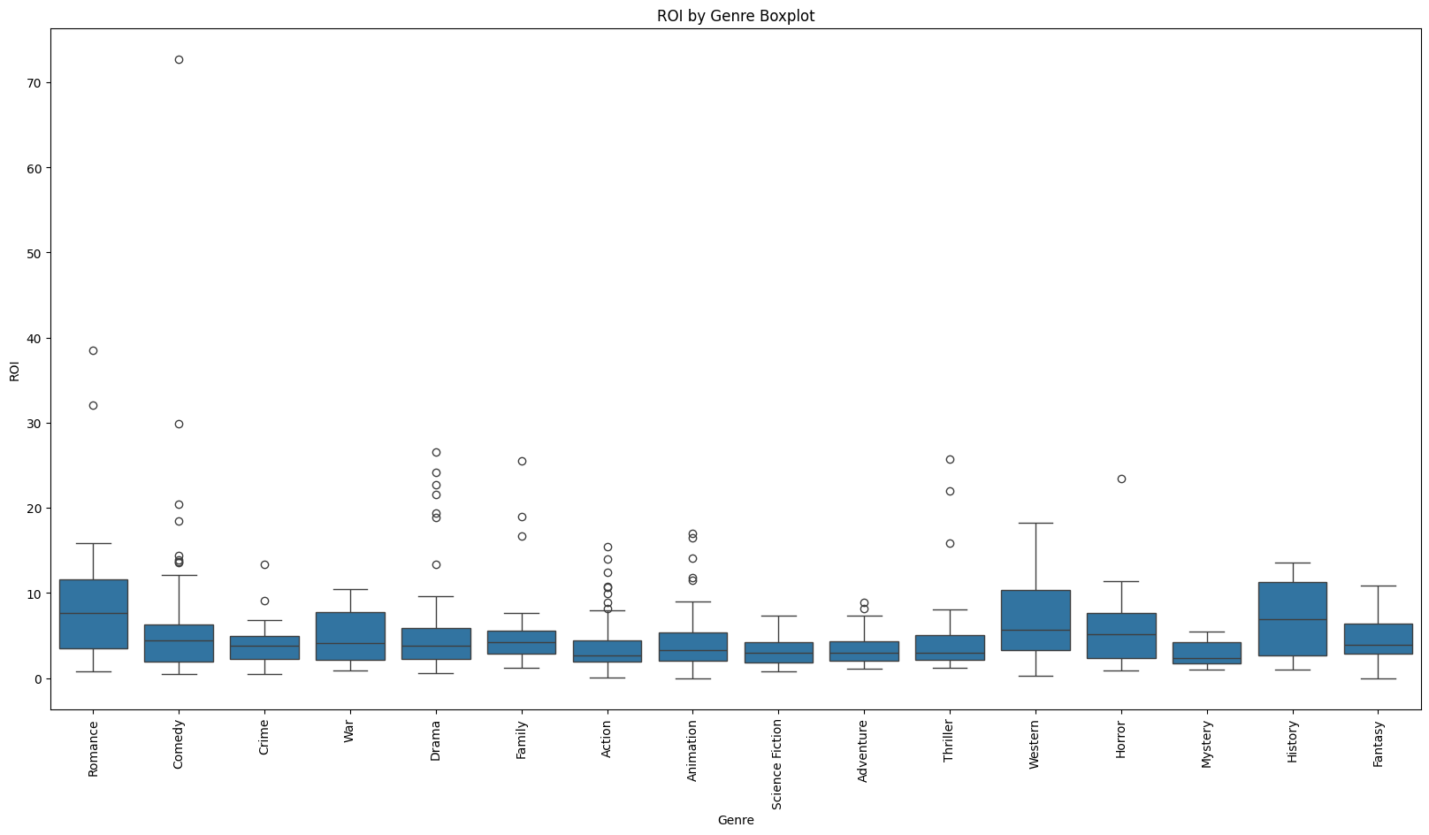
ROI by Genre
Blair Witch Project removed as outlier
ROI = 4132
My Big Fat Greek Wedding
Notes:
This boxplot shows movies’ return on investment (ROI) grouped by genre. ROI was calculated by taking the Net Profit/Budget. The Blair Witch Project was removed from the data set as an outlier because it had an ROI of 4132. My Big Fat Greek Wedding had the next highest ROI at 75. It is important to note that successful low budget movies will always return the highest ROIs. A low budget movie is a lower risk of investment and a higher chance for a bigger return.

Slide 10
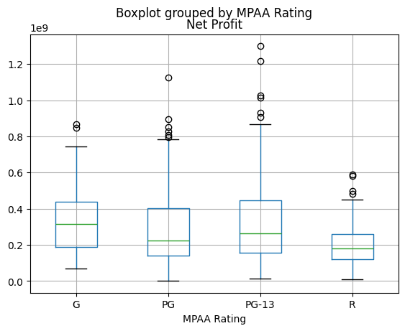
Net Profit grouped by MPAA Rating
Notes:
This Boxplot shows movies’ net profit in USD billions grouped by MPAA Rating. You can see PG-13 has the highest net profits. So PG-13 movies have the highest chance of the best return in net profit. R movies have the lowest net profits.

Slide 11
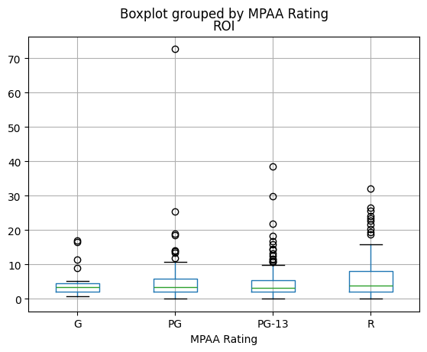
ROI grouped by MPAA Rating
My Big Fat Greek Wedding
Notes:
This Boxplot shows movies’ ROI grouped by MPAA Ratings. It shows that PG-13 and R movies have the best ROIs.

Slide 12
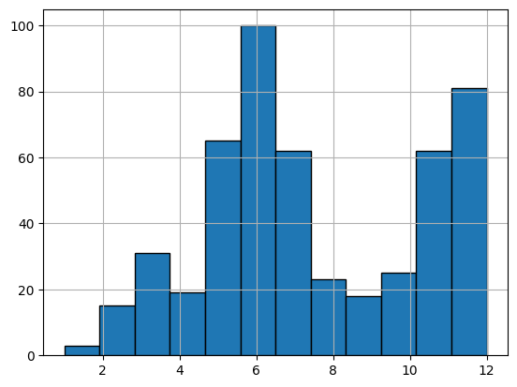
Movies Grouped by Month of Release
Number of Movies
Month
Notes:
This histogram shows the number of movies released by month. May, June, July, November and December have the most movie releases. So if you want to make a successful movie it would be best to release your film in those months. Hence the name summer blockbuster.

Slide 13
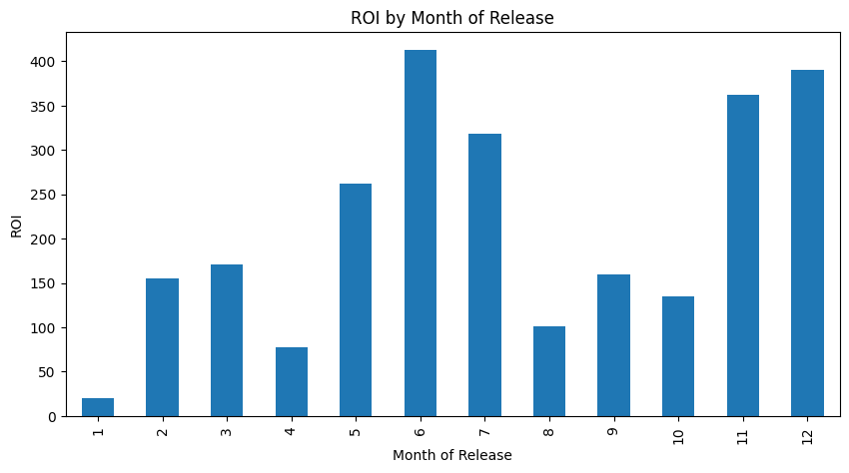
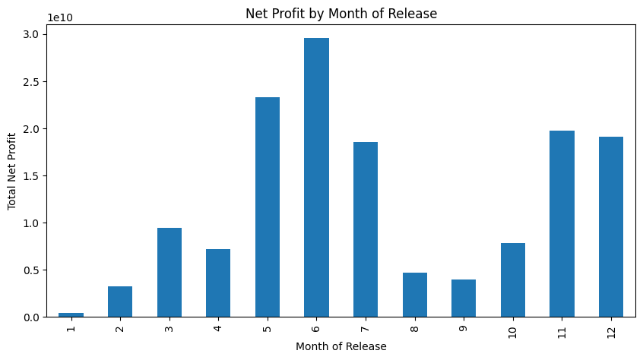
Release Date Grouped by Profits
Notes:
These graphs show movies’ ROIs and Net Profit grouped by month, respectively. They show movies released in May, June, July, November and December preform best.

Slide 14
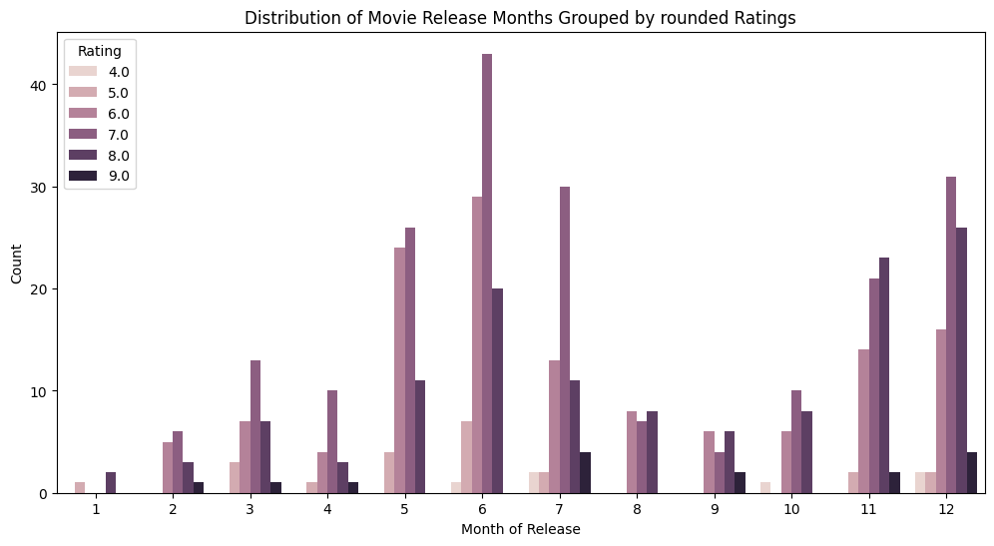
Release Date grouped by Ratings
Notes:
This graph shows movies review ratings grouped by month. Again, movies released in May, June, July, November and December have the best reviews.

Slide 15
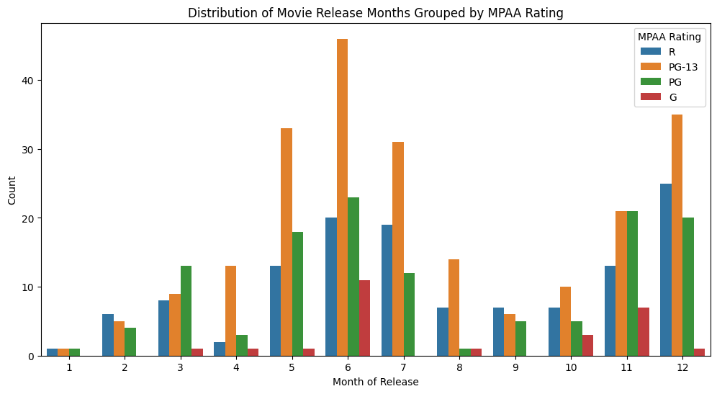
Release Date Grouped by MPAA Rating
Notes:
This graph shows the number of movies released by month grouped by MPAA rating. The most common rating is PG-13.

Slide 16
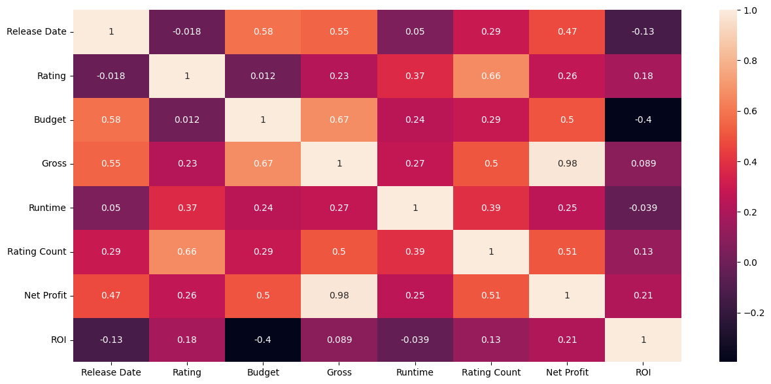
Heat Map Correlations
Notes:
This is a heat map of all the correlations in this data set. The circled values are the most correlated features. There are three predictive variables, gross, net profit, and ROI.
Gross and net profit were calculated off each other, so they have a very high correlation rate.
The movies’ ROI averages are similar for most the movies in this data set. That is why there are not high correlations when looking at it’s row.

Slide 17
Modeling
There were three predictive variables, Gross, ROI and Net Profit.
The Log of the Gross was chosen to be used for modeling
The month was encoded as a sine/cosine feature.
Linear, XGBoost, Random Forest, and SVR was testing for modeling
Notes:
Gross was chosen to be used as the predictive variable for modeling. ROI and Net profit were not included as features due to data leakage issues.
Month was encoded as sine/cosine features.
4 models were tested.

Slide 18
Model metrics
Model | Training R^2 | Testing R^2 | MAE | K Fold R^2
Random Forest | 0.9462 | 0.5729 | 0.3217 | 0.6038
XGBoost | 0.9462 | 0.516 | 0.337 | 0.5425
Linear Regression | 0.6082 | 0.5592 | 0.3442 | 0.5333
SVR | 0.8136 | 0.6063 | 0.3159 | 0.5837
SVR grid search |  | 0.6321 | 0.4211
Notes:
Model Metrics
SVR was chosen for the final model because it had the highest R^2 testing value, and the lowest mean absolute error (MAE). It also had less difference between training and testing R^2 values. Random forest and XGBoost models overfit the training data indicated by the difference between training and testing R^2 values.
The SVR grid search returned a testing R^2 0.03 higher than the default SVR model. However, also has a much higher MAE when compared to the default SVR model. The MAE represents tens of millions of dollars, so 0.31 to 0.42 is a very big difference.
It is important to note that Random forest K fold R^2 testing outperformed SVR’s K fold R^2.
Linear regression shows the least over fitting, preforms similar to the other models and takes much less time to compute. It would be a valid choice if we wanted the fastest computing time.

Slide 19
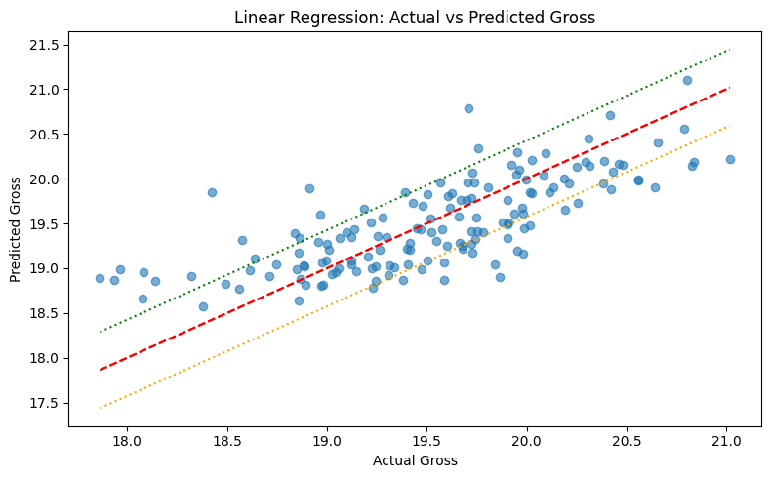
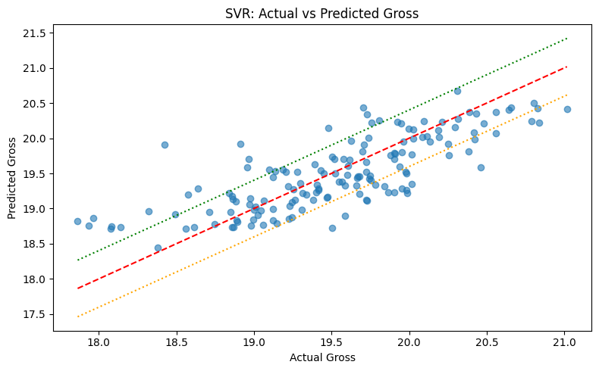
SVR and Linear Regression Graphs
Visually SVR and Linear Regression do not appear that different.
Linear regression processes faster.
Notes:
These graphs show Linear Regression and SVR models actual vs predictive values. We know that SVR preformed better than linear regression based on metrics, however visually they are very similar. You can also see that the movies in the data set have a narrow range of gross values.

Slide 20
Conclusion
This data set is of Hollywood blockbusters. It shows that successful movies have more critic reviews, higher ratings, and higher budgets.
Lower budget movies always have the best ROI and less risk
Movies released in the May-July or November-December are more successful.
The final model SVR
R squared value = 0.63
MAE = 0.42
That number looks small but represents millions of dollars.
Not the most helpful model
I think the most helpful information from this project is correlations between release month, review ratings and genres.
You can’t predict if a movie will flop if the data set has no bad movies
Notes:
This data only includes successful blockbuster movies. It can predict a movies success, but it cannot predict if a movie will flop. The final SVR model also isn’t helpful for lower budget movies because the MAE has a multimillion-dollar range. The model will only work for movies that have a budget of hundreds of millions of dollars, and most likely will already be successful.

Slide 21
Future Study
Should include
larger sample size
movie flops and blockbuster hits.
Future features
Directors
Production companies
Production time
Cast
ect.
more robust data set
Notes:
If this project was continued a data set with a larger sample size would be used. Also, the data set would need to include successful and unsuccessful movies to give us a more robust model.
More features could be added or created as well, such as directors, production companies, cast, days of the week, ect.

